Slide 1
HAND WRITTEN DIGITAL RECOGNITION USING CNN
Done By: V. Samyuktha
Reg.No.:912321104037
Branch: III CSE
College Name:SACS MAVMM Engineering College
Email ID:samutwins2004@gmail.com
Nanmudhalvan ID:au912321104037

Slide 2
PROJECT OUTLINE
Problem Statement
Proposed System / Solution
System Development Approach
Algorithm & Deployment
Result
Conclusion
Reference

Slide 3
PROBLEM STATEMENT
Handwritten digital recognition is a fundamental problem in pattern recognition and machine learning with numerous real-world applications, including automatic form processing, postal sorting, and bank check digitization. The objective of this project is to develop a robust and accurate based model capable of accurately recognizing handwritten digits from input images.

Slide 4
PROPOSED SYSTEM / SOLUTION
STEPS:
CNN Architecture Design
Data Preprocessing
Data Augmentation
Training Procedure
Validation and Testing
Deployment and Integration
Performance Monitoring and Updates
User Interface (Optional)

Slide 5
PROPOSED SYSTEM / SOLUTION(CONTD…)
1. CNN Architecture Design:
The system begins with the design of a CNN architecture optimized for handwritten digit recognition. This architecture typically comprises multiple convolutional layers followed by pooling layers for feature extraction, and fully connected layers for classification.
2. Data Preprocessing
Before training the CNN model, the system preprocesses the input images to enhance their quality and reduce noise. Common preprocessing techniques include normalization to scale pixel values between 0 and 1, resizing images to a standardized input size, and applying filters for noise reduction and contrast enhancement.

Slide 6
PROPOSED SYSTEM / SOLUTION(CONTD…)
3. Data Augmentation:
To mitigate the limited training data challenge, the system employs data augmentation techniques to increase the diversity of the dataset. Augmentation techniques may include random rotations, translations, scaling, and adding noise to artificially generate additional training samples.
4. Training Procedure:
The system trains the CNN model using the preprocessed and augmented dataset. Training involves optimizing the model parameters (weights and biases) using gradient-based optimization algorithms such as stochastic gradient descent (SGD) or Adam.

Slide 7
PROPOSED SYSTEM / SOLUTION(CONTD…)
5. Validation and Testing:
During training, a portion of the dataset is held out for validation to monitor the model's performance and prevent overfitting. Once training is complete, the system evaluates the trained model on a separate test dataset to assess its generalization ability and accuracy.
6. Deployment and Integration:
After successful training and evaluation, the trained CNN model is deployed for real-world applications. The system ensures compatibility with various deployment platforms, including desktop computers, mobile devices, and embedded systems. Integration with existing software or hardware systems may be necessary for seamless deployment.

Slide 8
PROPOSED SYSTEM / SOLUTION(CONTD…)
7. Performance Monitoring and Updates:
The system incorporates mechanisms for monitoring the performance of the deployed model in production environments. Metrics such as accuracy, inference time, and resource utilization are continuously monitored. Periodic updates to the model may be deployed to improve performance or adapt to changing requirements.
8. User Interface (Optional):
Depending on the application, the system may include a user interface for interacting with the handwritten digit recognition system. This interface could allow users to input handwritten digits via drawing or image upload and display the recognized digits along with confidence scores.

Slide 9
SYSTEM DEVELOPMENT APPROACH
a. HARDWARE REQUIREMENT:
GPU (Graphics Processing Unit):
GPUs excel at performing parallel computations, making them well-suited for accelerating deep learning training and inference tasks.For training CNN models.
. Memory (RAM):
For deep learning tasks, including handwritten digit recognition, a minimum of 16GB of RAM is recommended.
Storage:
Sufficient storage capacity is required to store datasets, trained models, and other project-related files.

Slide 10
SYSTEM DEVELOPMENT APPROACH(CONTD…)
b. SOFTWARE REQUIREMENT:
Python: Python is the primary programming language commonly used in deep learning projects due to its simplicity and extensive libraries support.
TensorFlow: TensorFlow is a popular open-source deep learning framework developed by Google. It provides comprehensive support for building and training neural networks, including CNNs.
PyTorch: PyTorch is another widely used deep learning framework known for its flexibility and dynamic computation graph capabilities. It offers a high-level interface for building CNNs and other neural network architectures.
NumPy: NumPy is a fundamental package for scientific computing in Python. It provides support for array operations and numerical computations, essential for data manipulation and preprocessing.
Pandas: Pandas is a powerful library for data manipulation and analysis. It's helpful for loading and preprocessing datasets, handling dataframes, and performing exploratory data analysis.

Slide 11
ALGORITHM & DEPLOYMENT
a.ALGORITHM:
Data Collection and Preprocessing:
Preprocess the images:
Resize images to a consistent size (e.g., 28x28 pixels).
Normalize pixel values to a range between 0 and 1.
Model Definition:
Define the CNN architecture:
Stack convolutional layers followed by activation functions (e.g., ReLU).
Add pooling layers (e.g., Max Pooling) to reduce spatial dimensions.
Optionally, include dropout layers for regularization.

Slide 12
ALGORITHM & DEPLOYMENT(CONTD…)
Model Compilation:
Specify loss function: Typically, categorical cross-entropy for multi-class classification.
Select an optimizer (e.g., Adam, SGD) and set learning rate.
Model Training:
The validation set to monitor for overfitting. Adjust hyperparameters based on validation. Split the dataset into training, validation, and test sets. Train the model using training data:
Feed batches of preprocessed images and corresponding labels into the model.
Update model weights using backpropagation and optimization algorithm.

Slide 13
ALGORITHM & DEPLOYMENT(CONTD…)
Model Evaluation:
Evaluate the trained model on the test set to assess its performance:
Calculate classification accuracy and other relevant metrics.
Visualize model predictions and compare them with ground truth labels.
Testing and Validation:
Test the deployed model with new handwritten digit images to ensure its accuracy and reliability in real-world scenarios.Validate the model against different handwriting styles, sizes, and backgrounds to assess its robustness.

Slide 14
ALGORITHM & DEPLOYMENT(CONTD…)
b. DEPLOYMENT:
Choose Deployment Platform:
Determine the platform(s) where the model will be deployed, such as:
Web application
Mobile application (iOS, Android)
Model Serialization:
Serialize the trained CNN model into a format suitable for deployment. Common serialization formats include:
TensorFlow Saved Model format (.pb)
PyTorch model checkpoint (.pt)

Slide 15
ALGORITHM & DEPLOYMENT(CONTD…)
Performance Optimization (Optional):
Optimize the deployed model and preprocessing pipeline for performance:
Reduce model size and computational complexity for faster inference.
Implement techniques like quantization or model pruning to reduce memory and processing requirements.
User Interface (UI):
Design a user-friendly interface for interacting with the deployed system:
Provide intuitive input methods for users to upload or capture handwritten digit images.
Display model predictions along with confidence scores or probabilities.

Slide 16
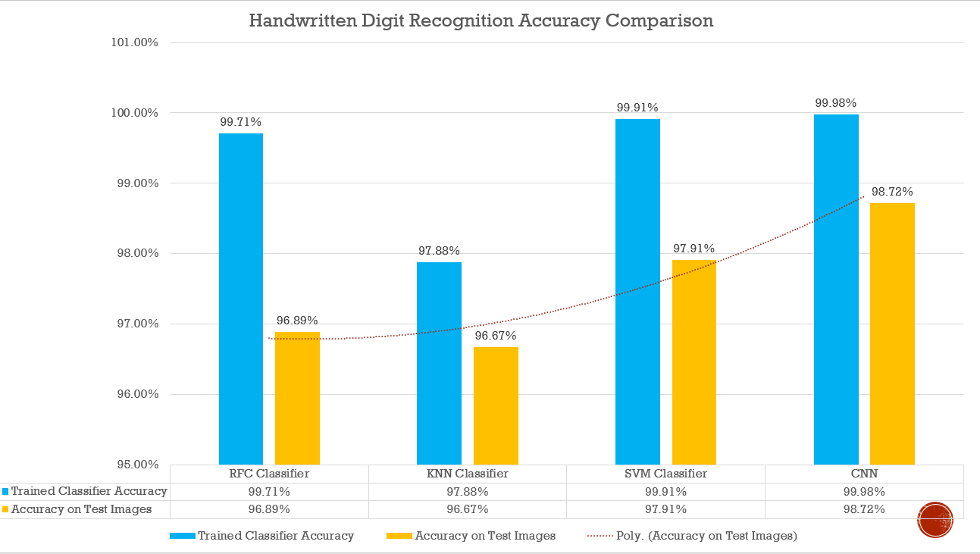
RESULT
Fig: Handwritten Digital Recognition Accuracy Comparison

Slide 17
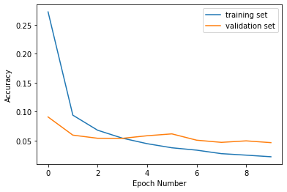
RESULT(CONTD…)
Fig: plot curve

Slide 18
CONCLUSION
In conclusion, the implementation of Convolutional Neural Networks (CNNs) for handwritten digit recognition represents a significant advancement in computer vision and pattern recognition. Through the development and deployment of CNN-based systems, we can achieve accurate and efficient recognition of handwritten digits, with numerous practical applications in various domains.

Slide 19
REFERENCE
https://www.tensorflow.org/
https://keras.io/
https://numpy.org/
https://matplotlib.org/
https://www.sky-learn.com/
https://www.kaggle.com/datasets/hojjatk/mnist-dataset
https://www.kaggle.com/code/itsmohammadshahid/7-cnn-handwritten-digit-recognition/input

Slide 20
THANK YOU

